Slide 1


Semester 443 - 2023, 1444
Course CS315 Algorithms Analysis and Design
Dictionaries and Hash Tables
Lecture 3
Prof. Dr Mohammed Al-Hagery
Athar alwabel
Supervisordr@yahoo.com
aa.alwabel@qu.edu.sa

Slide 2

Dictionary ADT (§2.5.1)
The dictionary ADT models a searchable collection of key-element items
The main operations of a dictionary are searching, inserting, and deleting items
Multiple items with the same key are allowed
Applications:
  address book
  credit card authorization
  mapping host names (e.g., cs16.net) to internet addresses (e.g., 128.148.34.101)
Dictionary ADT methods:
  findElement(k): if the dictionary has an item with key k, returns its element, else, returns the special element NO_SUCH_KEY
  insertItem(k, o): inserts item (k, o) into the dictionary
  removeElement(k): if the dictionary has an item with key k, removes it from the dictionary and returns its element, else returns the special element NO_SUCH_KEY
  size(), isEmpty()
  keys().

Slide 3
Log File (§2.5.1)
A log file is a dictionary implemented by means of an unsorted sequence
  We store the items of the dictionary in a sequence (based on a doubly-linked lists or a circular array), in arbitrary order.
Performance:
  insertItem takes O(1) time since we can insert the new item at the beginning or at the end of the sequence.
  findElement and removeElement take O(n) time since in the worst case (the item is not found) we traverse the entire sequence to look for an item with the given key
The log file is effective only for dictionaries of small size or for dictionaries on which insertions are the most common operations, while searches and removals are rarely performed (e.g., historical record of logins to a workstation)

Slide 4
Hash Functions and Hash Tables (HT) (§2.5.2)
A hash function h maps keys of a given type to integers in a fixed interval [0, N − 1]
Example:
h(x) = x mod N
is a hash function for integer keys
The integer h(x) is called the hash value of key x
A hash table for a given key type consists of
  Hash function h
  Array (called table) of size N
When implementing a dictionary with a hash table, the goal is to store item (k, o) at index i = h(k) // o is an object

Slide 5
Example
We design a hash table for a dictionary storing items (SSN, Name), where SSN (social security number) is a nine-digit positive integer
Our hash table uses an array of size N = 10,000 and the hash function
h(x) = last four digits of x (x is the key)
0
∅
1
025-612-0001
2
981-101-0002
3
∅
4
451-229-0004
…
9997
∅
9998
200-751-9998
9999
∅
size

Slide 6
Hash Functions (§ 2.5.3)
A hash function is usually specified as the composition of two functions:
Hash code map:
h₁: keys → integers
Compression map:
h₂: integers → [0, N − 1]
The hash code map is applied first, and the compression map is applied next on the result, i.e.,
h(x) = h₂(h₁(x))
The goal of the hash function is to “disperse”/scatter the keys in an random way. تجزئه

Slide 7
Hash Code Maps (§2.5.3)
Memory address:
  We reinterpret the memory address of the key object as an integer (default hash code of all Java objects)
  Good in general, except for numeric and string keys (ex. tops, pots), same binary code.
Integer cast:
  We reinterpret the bits of the key as an integer
  Suitable for keys of length less than or equal to the number of bits of the integer type (e.g., byte, short, int and float in Java)
Component sum:
  We partition the bits of the key into components of fixed length (e.g., 16 or 32 bits) and we sum the components (ignoring overflows).
  Suitable for numeric keys of fixed length greater than or equal to the number of bits of the integer type (e.g., long and double in Java).
  The summation is Hash code is not good why? see page 118.

Slide 8
Hash Code Maps (cont.)
Polynomial accumulation:
  We partition the bits of the key into a sequence of components of fixed length (e.g., 8, 16 or 32 bits)
  a₀ a₁ … a_{n−1}
  We evaluate the polynomial
  p(z) = a₀ + a₁ z + a₂ z² + …
  … + a_{n−1}z^{n−1}
  at a fixed value z, ignoring overflows.
  Especially suitable for strings (e.g., the choice z = 33 gives at most 6 collisions on a set of 50,000 English words)
Polynomial p(z) can be evaluated in O(n) time using Horner’s rule:
  The following polynomials are successively computed, each from the previous one in O(1) time.

Slide 9
Compression Maps (§2.5.4)
Division:
  h₂ (y) = y mod N
  The size N of the hash table is usually chosen to be a prime.
  The reason related to number theory and is outside the scope of this course.
Multiply, Add and Divide (MAD):
  h₂ (y) = (ay + b) mod N
  a and b are nonnegative integers such that
  a mod N ≠ 0
  Otherwise, every integer would map to the same value b

Slide 10
Multiply, Add and Divide (MAD)
  h₂ (y) = (ay + b) mod N
  a and b are nonnegative integers such that
  a mod N ≠ 0
  N = 5
  a = 15
  b = 2, y=3
  h₂ (3) = (45 + 2) mod 5
  = 47 mod 5 = 2
  h₂ (7) = (105 + 2) mod 5
  = 107 mod 5 = 2
  It would be always 2. Why?
  Because a mod N = 0

Slide 11
Collision Handling in HT (§ 2.5.5)
Collisions occur when different elements are mapped to the same cell.
Chaining: let each cell in the table point to a linked list of elements that map/assigned there.
0
∅
1
025-612-0001
2
∅
3
∅
4
451-229-0004
981-101-0004
Chaining is simple, but requires additional memory outside the table.

Slide 12
Linear Probing in HT
Key | N | Hash value
18 | 13 | 5
41 | 13 | 2
22 | 13 | 9
44 | 13 | 5
59 | 13 | 7
32 | 13 | 6
31 | 13 | 5
73 | 13 | 8
Open addressing: the colliding items are placed in a different cells of the table.
Linear probing handles collisions by placing the colliding item in the next (circularly) available table cell.
Each table cell inspected is referred to as a “probe”
Colliding items lump together, causing future collisions to cause a longer sequence of probes.
Example:
  h(x) = x mod 13
  Insert keys 18, 41, 22, 44, 59, 32, 31, 73, in this order
0
1
2
3
4
5
6
7
8
9
10
11
12
41
18
44
59
32
22
31
73
0
1
2
3
4
5
6
7
8
9
10
11
12

Slide 13
Search with Linear Probing
Algorithm findElement(k)
i ← h(k) // start at this cell h(k)
p ← 0
repeat
c ← A[i]
if c = ∅ //empty location
return NO_SUCH_KEY
else if c.key () = k
return c.element()
else
i ← (i + 1) mod N
  p ← p + 1
  until p = N
return NO_SUCH_KEY
Consider a hash table A that uses linear probing
findElement(k)
  We start at cell h(k)
  We probe/Check consecutive locations until one of the following occurs:
    An item with key k is found, or
    An empty cell is found, or
    N cells have been checked without benefit.

Slide 14
Updates with Linear Probing
To handle insertions and deletions, we introduce a special object, called AVAILABLE, which replaces deleted elements.
removeElement(k)
  We search for an item with key k.
  If such an item (k, o) is found, we replace it with the special item AVAILABLE and we return element o /object o
  Else, we return NO_SUCH_KEY
insert Item(k, o)
  We throw an exception if the table is full.
  We start at cell h(k)
  We probe consecutive cells until one of the following occurs.
    A cell i is found that is either empty or stores AVAILABLE, or
    N cells have been unsuccessfully probed
  We store item (k, o) in cell i.

Slide 15
Double Hashing
Double hashing uses a secondary hash function d(k) and handles collisions by placing an item in the first available cell of the series.
  props= (i + jd(k)) mod N
  for j = 0, 1, … , N − 1
  i is the value of h(k), assigned before, see the next table.
The secondary hash function d(k) cannot have zero values.
The table size N must be a prime to allow probing of all the cells to handle collisions.
Common choice of compression map for the secondary hash function: d₂(k) = q − (k mod q)
where
  q < N
  q is a prime
The possible values for d₂(k) are
1, 2, … , q

Slide 16
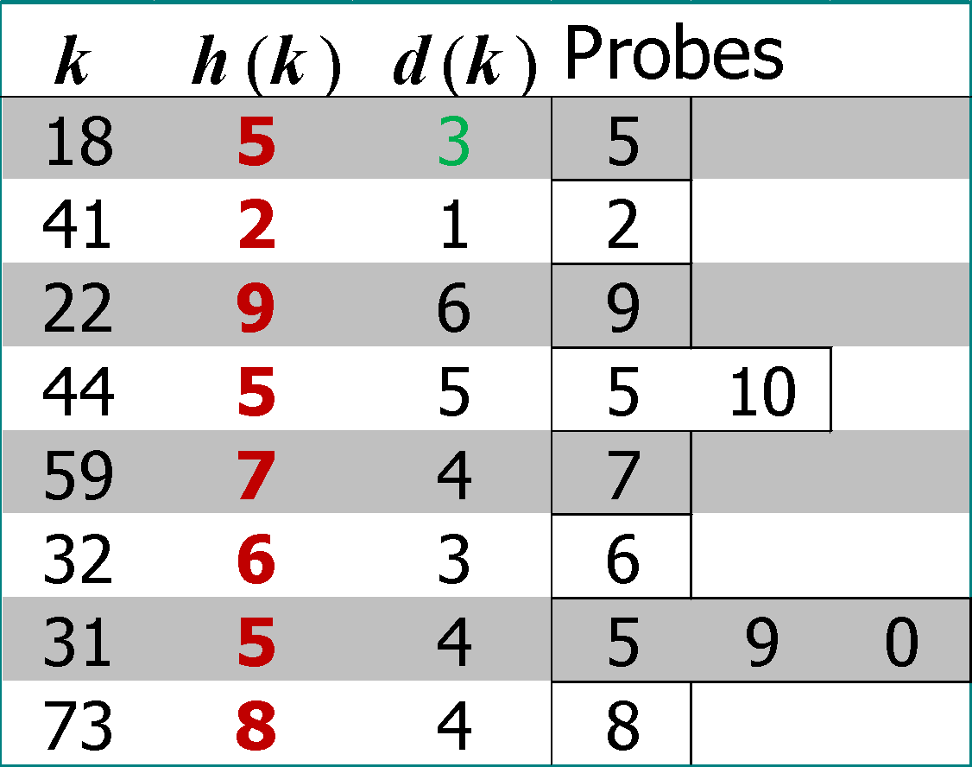
Double Hashing
Consider a hash table storing integer keys that handles collision with double hashing
  for example If k =18, N = 13
  h(k) = k mod 13 =5
  to find d₂(k), let q=7
  d₂(k) = q − (k mod q)
  d(k) = 7 − (k mod 7)
  d(18) = 7 − (18 mod 7)
  =7-4 =3
Insert keys 18, 41, 22, 44, 59, 32, 31, 73, in this order
Key | N | Hash value
18 | 13 | 5
41 | 13 | 2
22 | 13 | 9
44 | 13 | 5
59 | 13 | 7
32 | 13 | 6
31 | 13 | 5
73 | 13 | 8
0
1
2
3
4
5
6
7
8
9
10
11
12
31
41
18
32
59
73
22
44
0
1
2
3
4
5
6
7
8
9
10
11
12
Probes calculations:
To prob a new solution apply this technique:
for j = 0, 1, … , N − 1
New solution = (i + jd (k)) mod N, where i=h(k)

Slide 17
Performance of Hashing
In the worst case, searches, insertions and removals on a hash table take O(n) time
The worst case occurs when all the keys inserted into the dictionary collide (تحدث أسوأ حالة عندما تتعارض جميع المفاتيح التي تم إدخالها في القاموس)
The load factor is called α affects the performance of a hash table.
Assuming that the hash values are like random numbers, it can be shown that the expected number of probes for an insertion with open addressing is: 1 / (1 − α) , α = N/M
The expected running time of all the dictionary ADT operations in a hash table is O(1)
In practice, hashing is very fast provided the load factor is not close to 100%.
Other applications of hash tables:
  small databases
  compilers
  browser caches

Slide 18
Rehashing
The load factor is computed as: α = N/M where M = size of the table,
N = number of keys that have been inserted in the table
Rehashing is a technique in which the table is resized, i.e., the size of table is doubled by creating a new table.

Slide 19
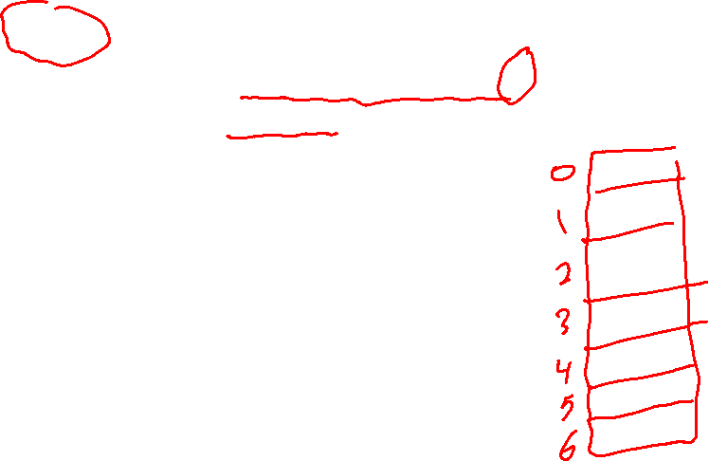
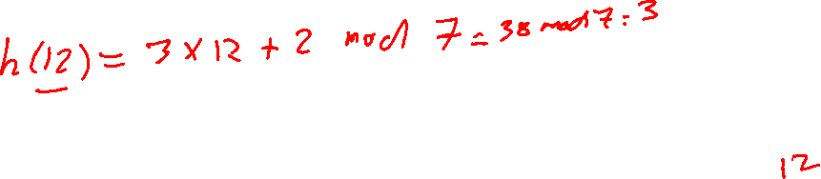
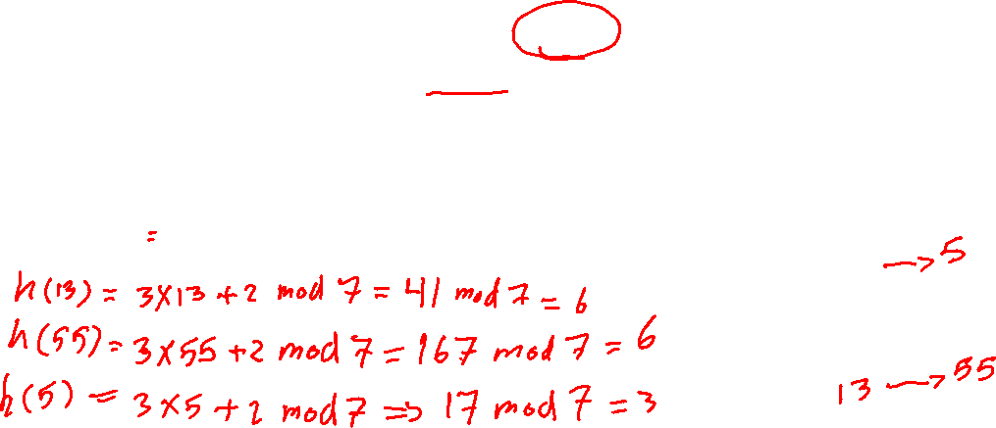
Example :-
Draw the 7-item hash table resulting from hash keys 12,44,13,55 and 5, using the hash function h(i) = (3i+2) mode 7 and assume that collisions are handled by chaining.

Slide 20
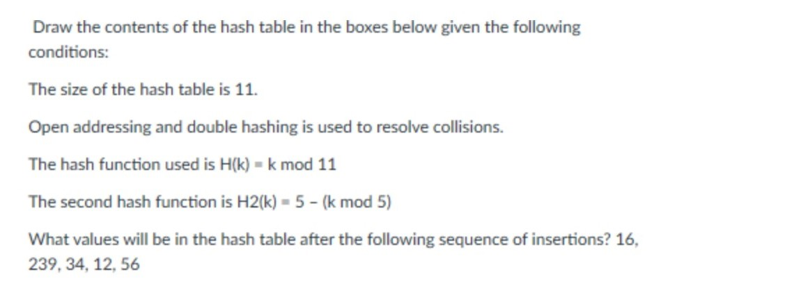
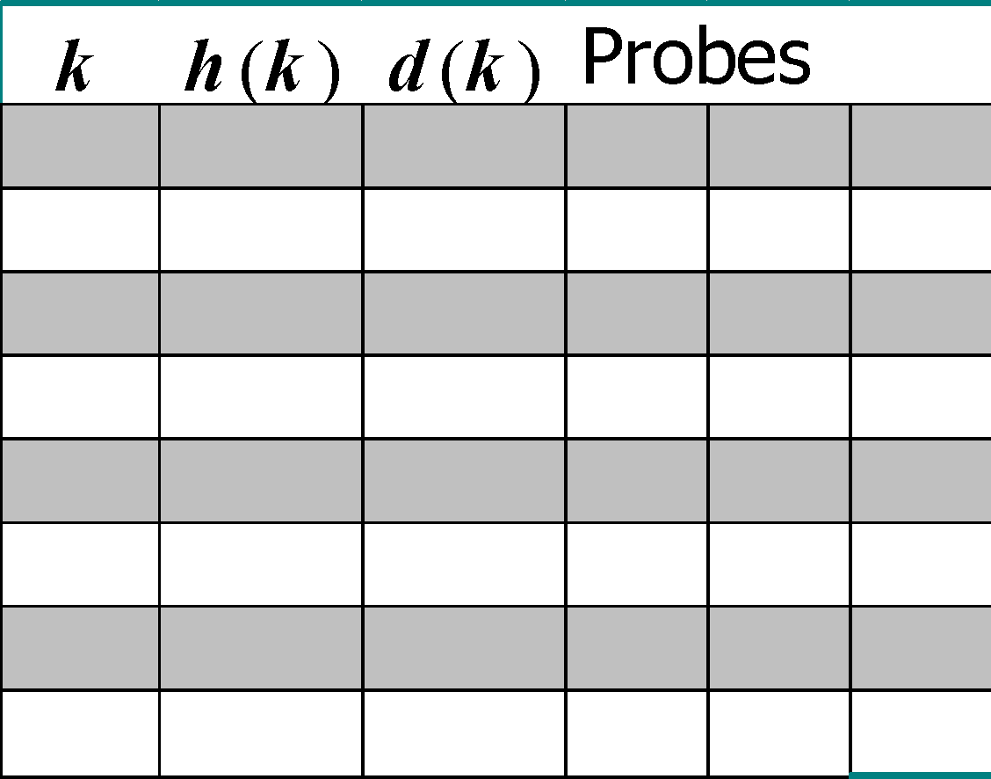
Example :-
0
1
2
3
4
5
6
7
8
9
10
0
1
2
3
4
5
6
7
8
9
10

Slide 21
The End ..
This lecture was from
Algorithm Design: Foundations, Analysis, and Internet Examples
By Michael T. Goodrich, Roberto Tamassia
chapter 2.5
Introduction_to_Algorithms_Third_Edition_(2022)
chapter 11

